Slide 1


Parallel and Distributed Systems / 7
Pavel Krömer, Dept. of Computer Science, VSB – Technical University of Ostrava

Slide 2
Agenda
General Purpose GPUs
Compute Unified Device Architecture (CUDA)
Literature
Norman Matloff: Parallel Computing for Data Science With Examples in R, C++ and CUDA, CRC Press 2016
Tolga Soyata: GPU Parallel Program Development Using CUDA, Chapman & Hall/CRC Computational Science, CRC Press, 2018
Brian Tuomanen: Hands-On GPU Programming with Python and CUDA, Packt Publishing Ltd. 2018

Slide 3
GPUs and GPU Computing
Notes:
what do we associate with digital transformation/DSM?
Is that all new? Is this change the first?

Slide 4
GPU Computing
GPU-accelerated computing is the use of a Graphical Processing Units (GPUs) together with a CPU to accelerate scientific, analytics, engineering, consumer, and enterprise applications.
General Purpose GPUs allow massively parallel execution of arbitrary applications following the SIMD model.
An essential part of HPC and cloud computing.
T. Soyata: “There is no such thing as GPU Programming ...
GPU always interfaces to the CPU through certain APIs ...
So, there is always CPU+GPU programming ...”

Slide 5
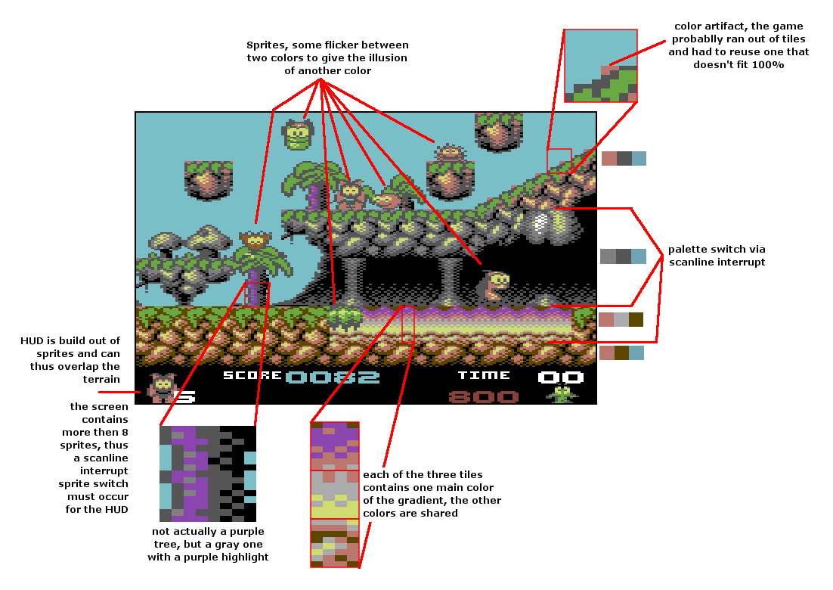
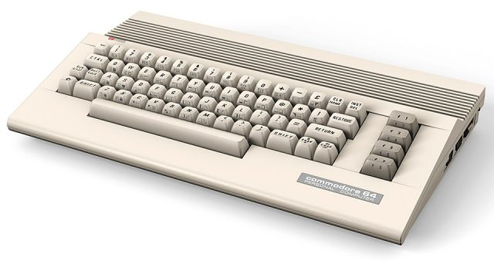
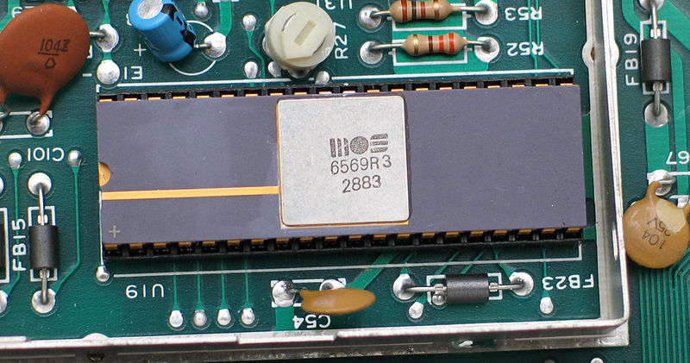
History of GPUs: how Games changed the World
There were some amazing devices long before GPUs
VIC-II ‘graphic chip’, 8 sprites and tons of fun (32)

Slide 6
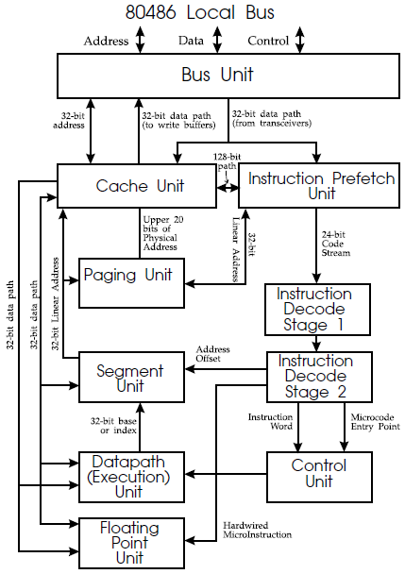
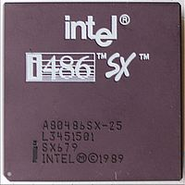
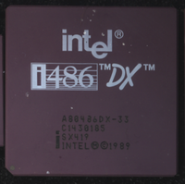
History of GPUs: how Games changed the World
There were some amazing devices before GPUs
VS
X

Slide 7
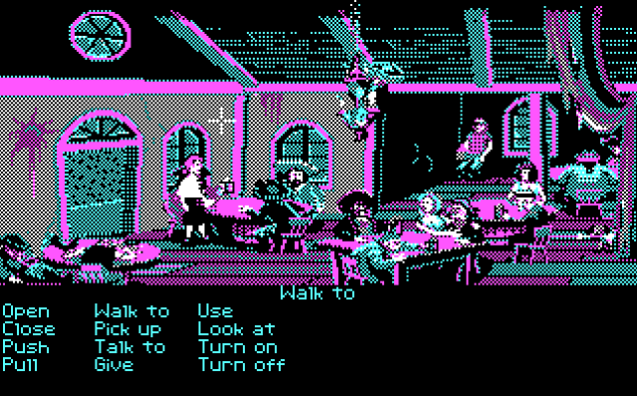

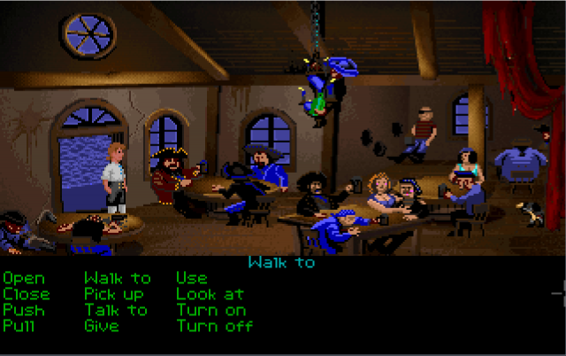
History of GPUs: how Games changed the World
There were some amazing devices before GPUs
VS
CGA
EGA
VGA

Slide 8
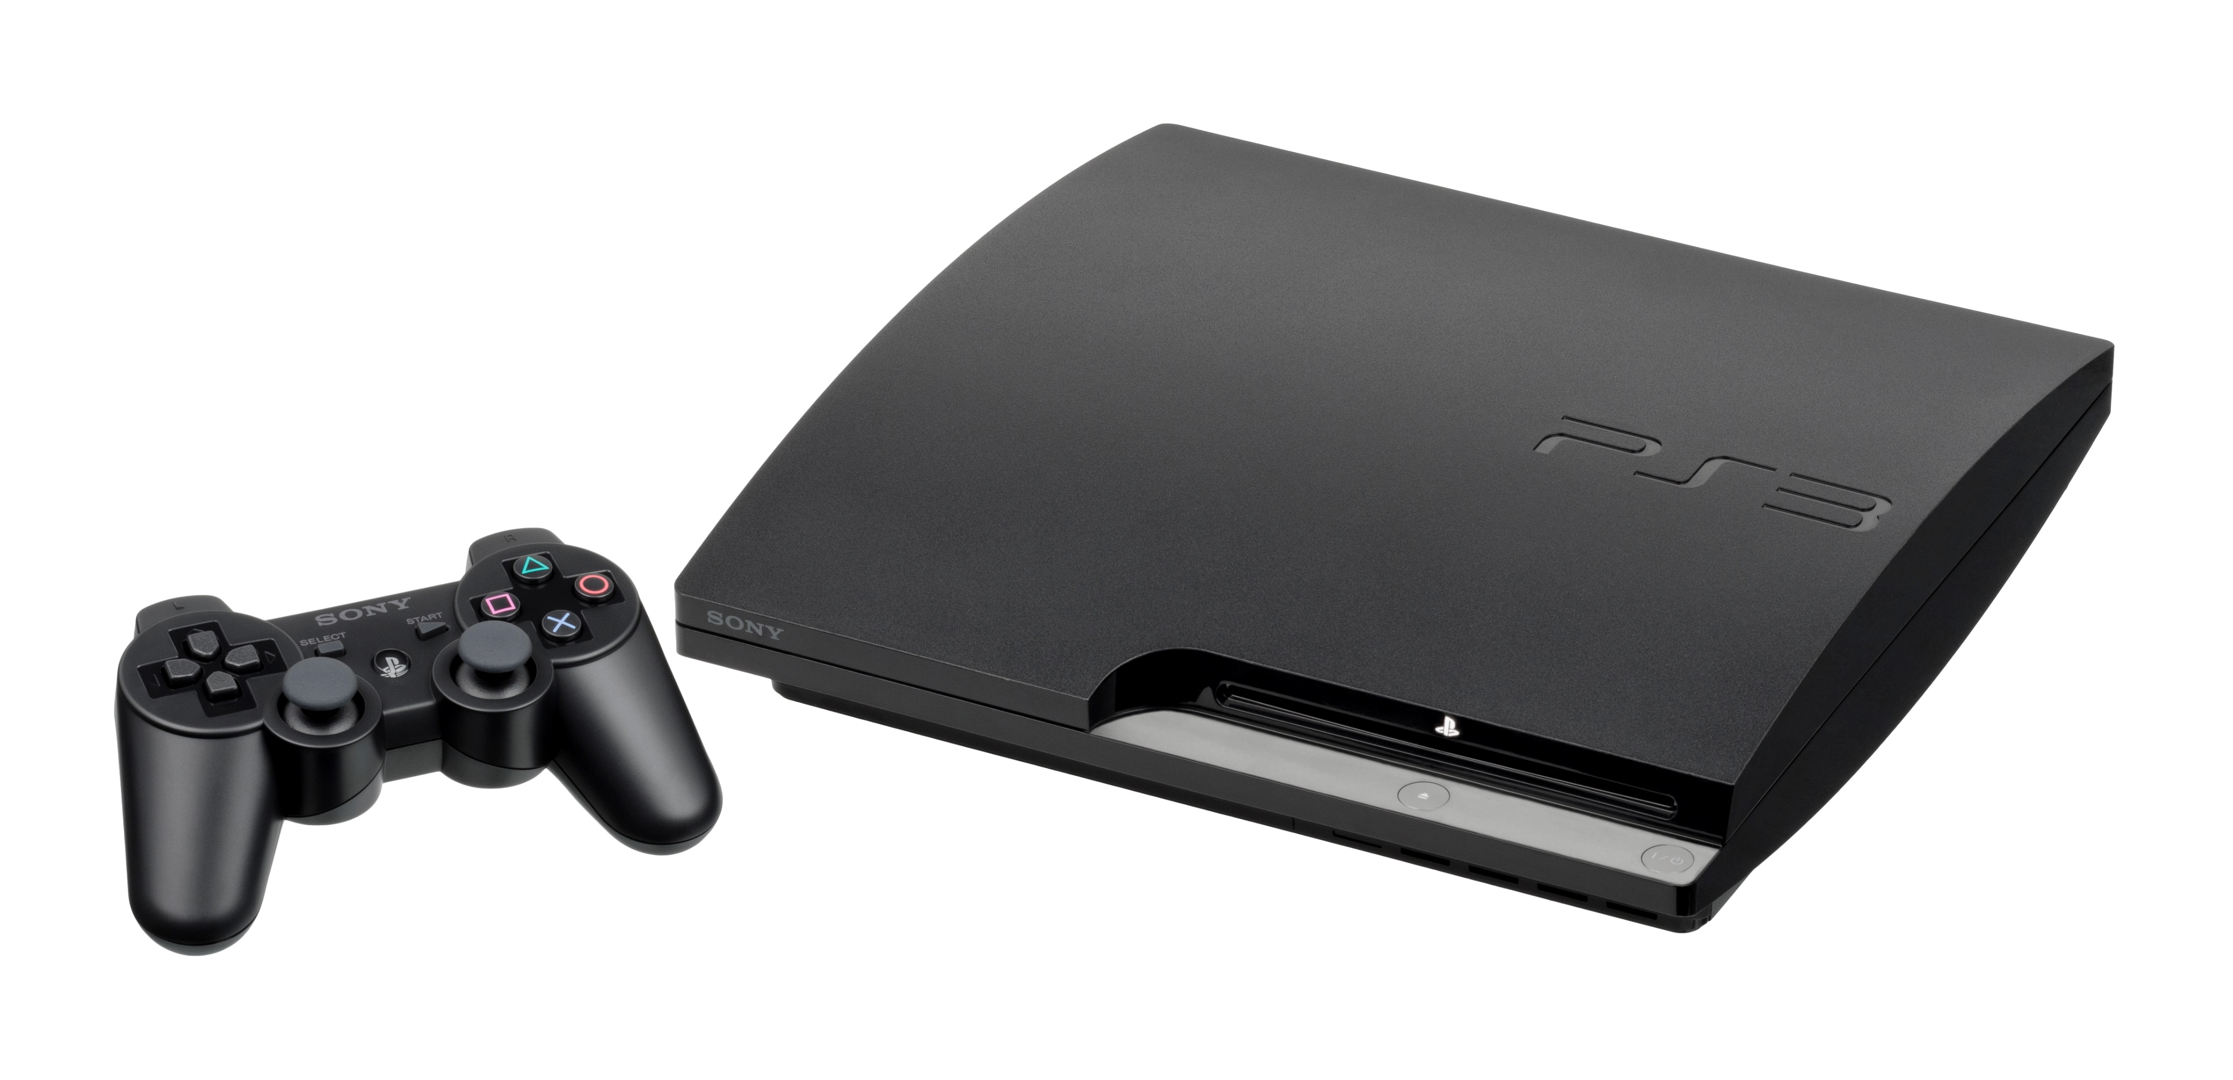
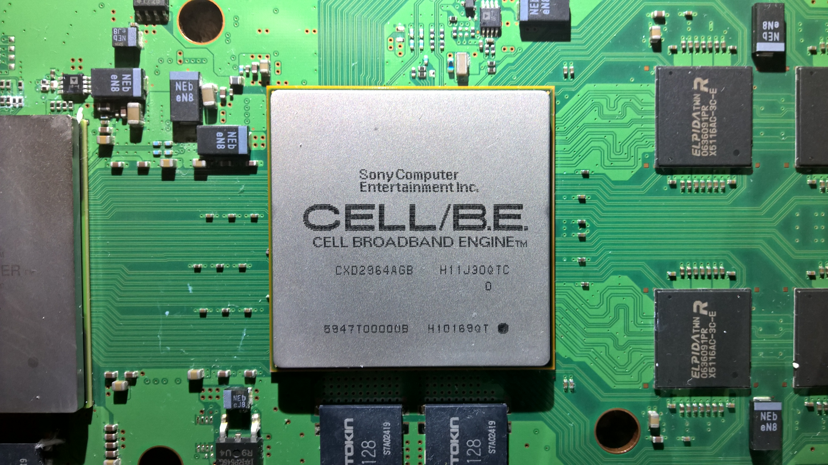
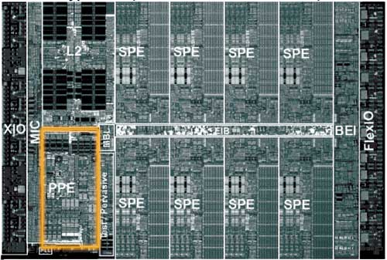
History of GPUs: how Games changed the World
There were some amazing devices before GPUs
IBM CELL – power PC with 1 ‘full’ core and 8 co-processors

Slide 9
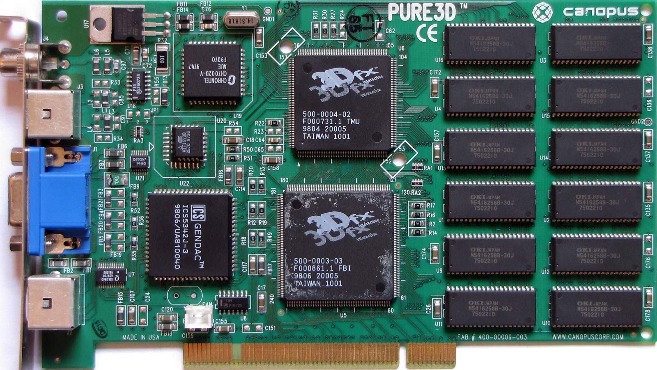
History of GPUs: how Games changed the World
GPUs
extension (graphic) cards with dedicated hardware developed for 3D computer graphics
not only display, but also real-time computation and rendering of 3D scenes composed of large number of polygons
highly parallel hardware for polygon processing, blending, antialiasing, shadow and lightning etc.

Slide 10
Gaming GPU timeline
Fast development driven by the gaming industry
1995 - S3 ViRGE, ATI Rage 3D,
1996 - 3dfx Voodoo 1
1997 - NVidia Riva 128, ATI Rage Pro, 3dfx Rush
1998 - S3 Savage 3D, Intel GMA, 3dfx Voodoo2, 3dfx Voodoo Banshee, Nvidia
NV4 (Riva TNT), ATI Rage 128 (Pro, Allin- Wonder)
1999 - S3 Savage 4, 2000, Nvidia Riva TNT2 Vanta/Pro/Ultra 3dfx Voodoo3, Nvidia
GeForce 256 (NV10)

Slide 11
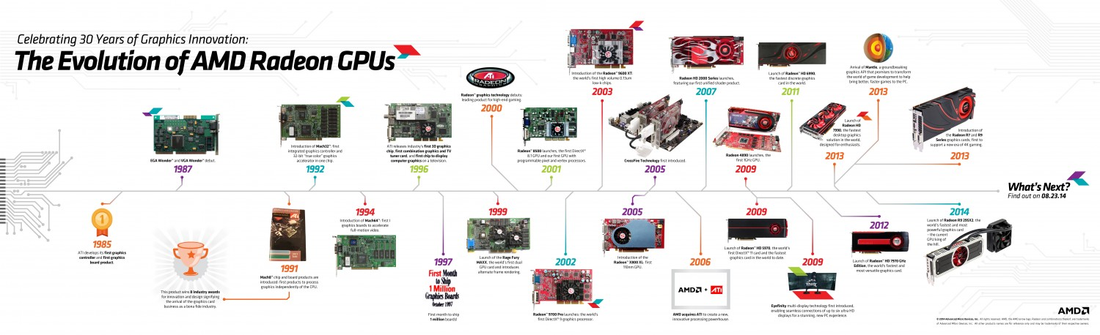
Gaming GPU timeline
Growing performance and more capabilities
Hardware T&L
shaders
vertex, pixel, geometry, different programming technologies (register combiners)
GC language
later unified
The use outside of gaming industry
HPC and scientific computing
2006 - CUDA standardization (NVidia)
CUDA-C language, simple general-purpose GPU programming
2008 OpenCL standardization
parallel programming of heterogeneous system
OpenCL C dialect

Slide 12
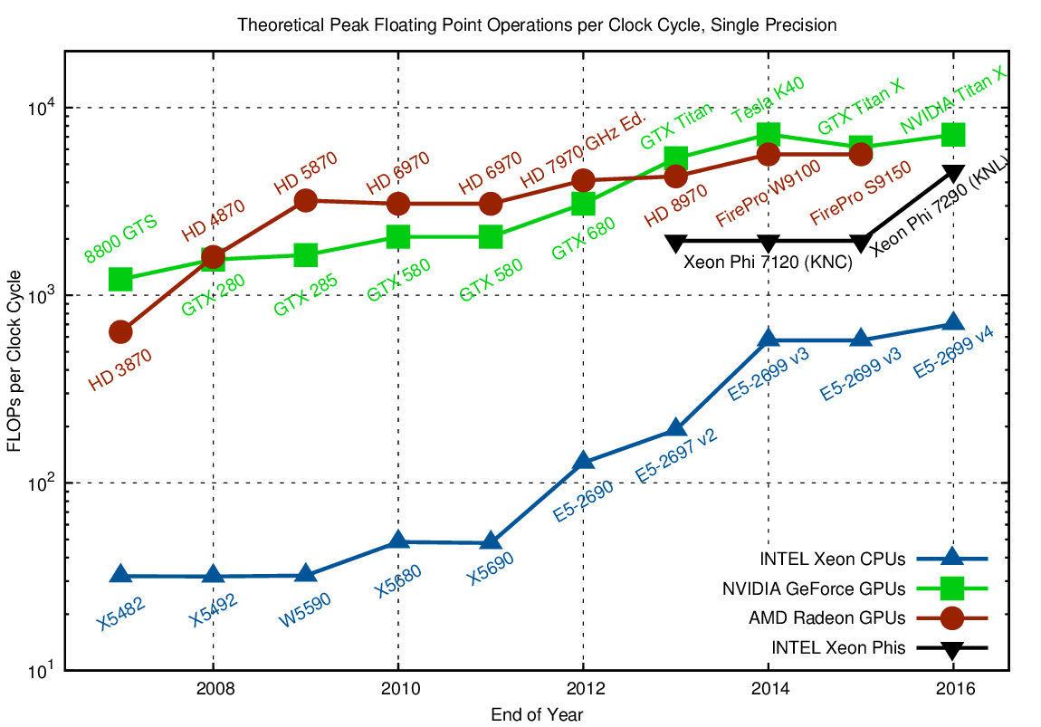

Slide 13
General Purpose GPUs
Notes:
what do we associate with digital transformation/DSM?
Is that all new? Is this change the first?

Slide 14
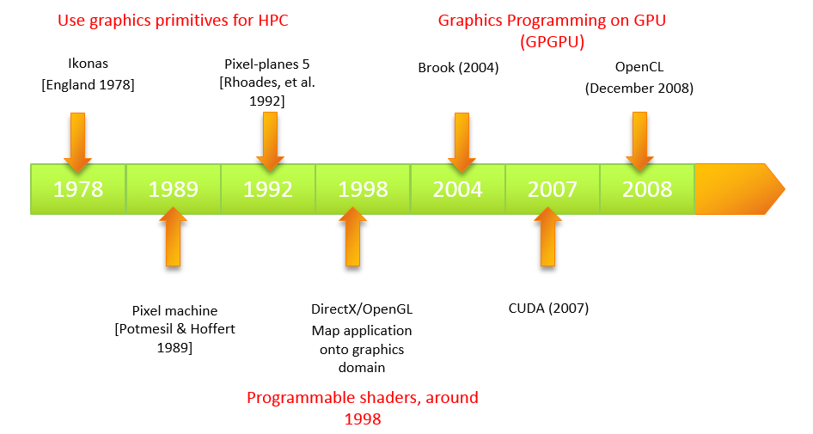
The use of GPUs for HPC
The pre-GPGPU era
translate the problem in terms of graphics operations and certain API (e.g. OpenGL)
2002, Real-Time Consensus-Based Scene Reconstruction using Commodity Graphics Hardware
2003, Hierarchical Splatting of Scattered Data

Slide 15
The use of GPUs for HPC
The GP
supercomputing for masses
NVidia is now
“a supercomputing company”
“a software company”
“an AI computing company” (2019)
the dawn of dedicated floating-point accelerators (NVidia Tesla, Fermi, Kepler, Maxwell, Pascal, Volta, Turing)

Slide 16
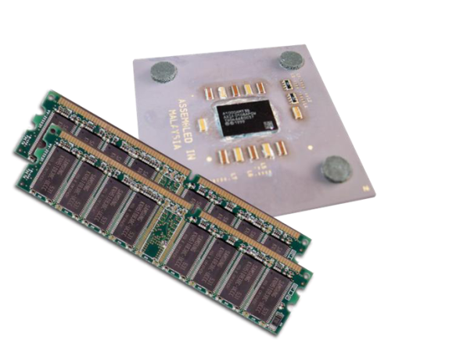
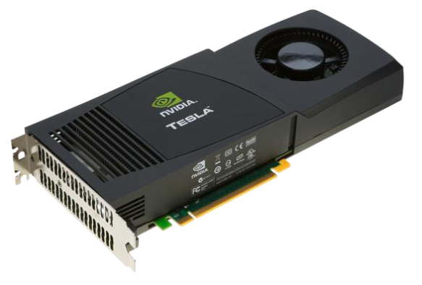
GPGPU vs CPU
GPGPU programming must take into account the different architecture of multiprocessors and GPGPUs.
CPUs vs GPUs
general purpose CPUs vs highly specialized GPUs
strongly optimized for their tasks
CPU is optimized for sequential processing of instructions (sic; multicore, SIMD inst., pipeline optimizations)
growing CACHEs to reduce latency
CPUs with slower but larger memories (compared to GPUs)
GPUs with thousands of cores, fast but limited memories, different cache philosophy, and SIMD restrictions
development of algorithms and applications for GPUs is challenging, some problems (e.g., iterative algorithms) are not suitable for GPUs

Slide 17
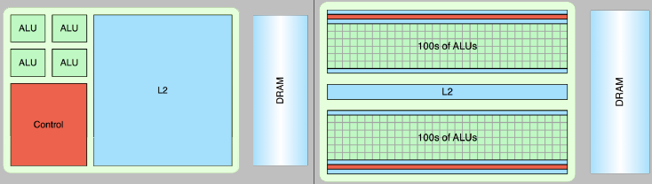
GPGPU vs CPU
Multicore CPU
Manycore GPU
Fast serial processing
Latency-optimized cores
Scalable parallel processing
Throughtput-optimized cores
Energy-efficiency
Notes:
CPUs:
Powerful ALUReduced operation latency
Large cachesConvert long latency memory accesses to short latency cache accesses
Sophisticated controlInstruction dependency analysis and superscalar operation
Branch prediction for reduced branch latency
Data forwarding for reduced data latency
GPUS:
Small cachesHigh bandwidth main memory
Simple controlNo branch prediction
No data forwarding
Energy efficient ALUsMany, high latency, ALUsheavily pipelined for high throughput
Requires massive number of threads to tolerate latenciesThreading logic
Thread state

Slide 18
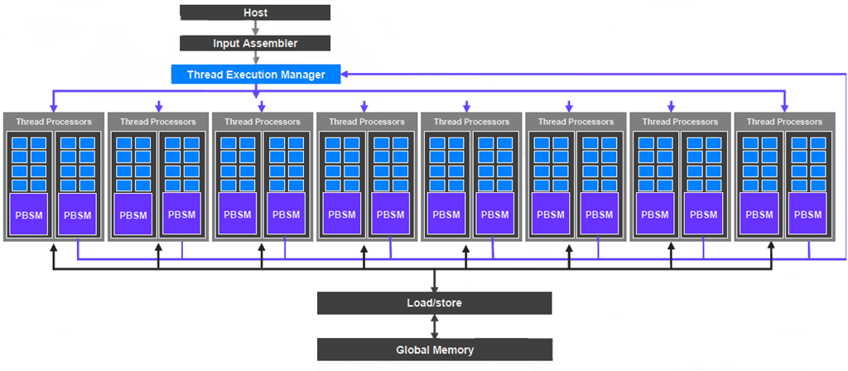
GPGPU architecture

Slide 19
Example: Volta V100
Up to 84 SMs
6MB of shared L2 cache
8 memory controllers, 6 NVLink interfaces, PCIe host interface

Slide 20
Example: Volta V100 SM
64 single‐precision FP32 arithmetic units
32 double‐precision FP64 arithmetic units
64 integer arithmetic units
16 special function units
8 tensor cores (4 x 4 matrix multiply)
32 load/store units
64K registers
allocated across threads
128KB data cache / shared memory
L1 data cache
user-allocated shared memory
4 warps can be running concurrently
up to 2 instructions per warp concurrently

Slide 21
GPGPU program
host code - executed on the host computer by CPU. Can be single or multi threaded. Launches CUDA kernels.
kernels - CUDA-C program that is executed on the GPU by many cores at the same time in a SIMD manner. Can use only CUDA-C and device libraries (i.e. no cstdlib etc.).
kernel launch configuration specifies the block and thread count (optionally shared memory size)
kernel_name<<<block_count, thread_count[,shared_mem]>>>(args);

Slide 22
GPGPU program
block_count and thread_count are potentially more-dimensional variables (wrt. processing of matrices and images)
Maximum number of threads per block: 512/1024 (Fermi)
Max dimension size of a thread block (x,y,z): (1024, 1024, 64)
Max dimension size of a grid (x,y,z): (2147483647, 65535, 65535)
represents the number of threads that can share the same memory and easily synchronize
at runtime, threads are organized into warps that are executed concurrently
1 warp = 32 threads
one warp is executed by a single stream processor in a SIMD way
divergence (e.g. branching) is a problem to be avoided
many optimizations, e.g. accesses to memory (memory read broadcasts), etc.
kernel_name<<<block_count, thread_count[,shared_mem]>>>(args);

Slide 23
GPGPU program
The launch configuration is mapped onto available hardware.
Runtime execution involves planning and scheduling (by the Giga Thread Scheduler, GTS).
Kernel return implies a synchronization, but does not perform any memory transfers

Slide 24
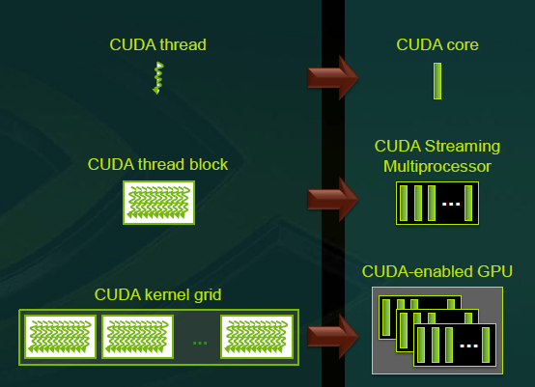
GPGPU memory hierarchy
cudaDeviceSynchronize
host memory - computer RAM
device memory - located on the GPU device, explicit transfers between host and device
global memory - the largest on device memory, slow compared to other types of on-device memory
constant memory - fast, small, read-only memory
texture memory - read-only memory with optimized reads from co-located addresses
shared memory - fast, small memory shared across threads within a block
Host and device memory
Separate address spaces (compute capability <6.0) cudaMemCopy to move data back and forth
Unified address space (compute capability >= 6.0) host and device “page” out of a single address space, cudaMallocManaged(), cudeDeviceSynchronize()

Slide 25
GPGPU programming: CUDA-C
A C dialect for Nvidia’s GPGPUs
Syntactic elements of CUDA-C
keywords
function ‘’annotations” global, device
shared memory defined by the shared keyword
variables
blockIdx.x (y, z), threadIdx.x (y, z)
gridDim.x (y,z), blockDim.x (y,z)
functions and constants
cudaMalloc(. . . ).
cudaMemcpy(. . . )
cudaMemcpyDeviceToHost
data types
cudaError_t, int2, int3
compilation
compiler nvcc, *.cu source files
specification of target architecture (-arch=sm_12)
development
NVidia nsight (Eclipse, Visual Studio add-on)
visual profiler, debugger

Slide 26
CUDA-C Hello World
Example
#include <stdio.h>
const int N = 16;
const int blocksize = 16;
__global__ void hello(char *a, int *b) {
a[threadIdx.x] += b[threadIdx.x];
}
int main(){
char a[N] = "Hello \0\0\0\0\0\0";
int b[N] = {15, 10, 6, 0, -11, 1, 0, 0, 0, 0, 0, 0, 0, 0, 0, 0};
char *ad; int *bd;
const int csize = N*sizeof(char); const int isize = N*sizeof(int);
cudaMalloc( (void**)&ad, csize );
cudaMalloc( (void**)&bd, isize );
cudaMemcpy( ad, a, csize, cudaMemcpyHostToDevice );
cudaMemcpy( bd, b, isize, cudaMemcpyHostToDevice );
dim3 dimBlock( blocksize, 1 );
dim3 dimGrid( 1, 1 );
hello<<<dimGrid, dimBlock>>>(ad, bd);
cudaMemcpy( a, ad, csize, cudaMemcpyDeviceToHost );
cudaFree( ad ); cudaFree( bd );
printf("%s\n", a);
sleep(1);
return EXIT_SUCCESS;
}

Slide 27
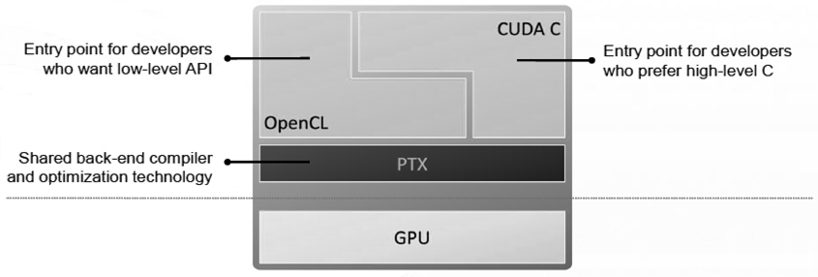
Other technologies
Other standards and languages for GPU and accelerator computing include Open CL, Open ACC, and OpenMP 4.
Open CL
Framework for writing programs that execute across heterogeneous platforms consisting of CPUs, GPUs, digital signal processors (DSPs), field-programmable gate arrays (FPGAs) and other processors
Open ACC
Collection of compiler directives to specify loops and regions of code in standard C, C++ and Fortran to be offloaded from a host CPU to an attached accelerator.
OpenMP 4
pragma omp target - describes regions of code where data and/or computation should be moved to another computing device.

